Slide 1



THEORY OF PROBABILITY
PART 1

Slide 2


PLAN:
Events
Probabilities of events
Compatible and incompatible events
Addition and multiplication of probabilities
Probability distributions
Expectation values, variance, mean-squared error

Slide 3


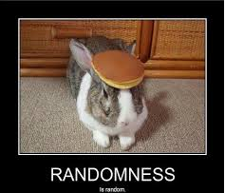
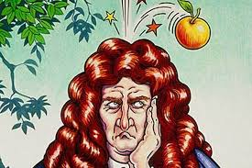
Types of Events
Certain events are events which, as a result of many trials (which are measured by recording the causal actions and the result) have been determined to always occur.
Impossible events are events which never occur during any trials.
Random events which can either occur or not occur in the course of a trial. These events are associated with randomness: a random event is preceded by causal factors, and it is either truly impossible on unreasonably difficult to predict the outcome beforehand.

Slide 4





Events
BASIC DEFINITIONS
COLLECTIVELY EXHAUSTIVE EVENTS
EVENT
OUTCOME

Slide 5

Events – Basic Definitions
Event – A trial which is succeeded by and influences a certain outcome.
Events (any) are denoted by capital letters.
Outcome - The result of any trial, which is characterized by something happening.
Incompatible events - one event occurring excludes the other event from occurring.
Complementary events – events which are directly opposite to one-another
(ie. coin toss leading to heads or tails).
Collectively exhaustive events – The set of all incompatible events determines the complete group of outcomes, provided that with any event, one of these outcomes will be realized.
Elementary event – An event is called ‘elementary’ if it can only lead to one outcome.

Slide 6

Probability of an outcome
The probability of a given outcome in any trial is denoted by the following equation:,
n – Total number of equally probably, elementary outcomes of the trial, which form the complete group of outcomes;
m – number of total outcomes, which are caused by event A.
The sum of all possible outcomes which make up the set of collectively exhaustive events is equal to 1.
If outcomes make up the total set of possible outcomes, then there is a 100% chance that one of them will be realized. In a very simple case, two opposite outcomes make up the collectively exhaustive set of events, ie:
– Tossing a coin leads it to fall on the ‘heads’ side; – Tossing a coin leads it to fall on the ‘tails’ side.
As per the theorem:

Slide 7
Addition and multiplication of probabilities
The sum of two events (logical OR) A and B is denoted by another event A + B, which means that the outcome of an event will be either event A or event B (or both). If these events are incompatible, only event A or event B can occur.
Theorem for adding probabilities of incompatible events - the probability of one of two incompatible events A or B occurring (either one), is equal to the sum of their probabilities: P(A + B) = P(A) + P(B)
The product of two events (logical AND) A and B is denoted by another event A*B, which contains both events A and B. The product A*B indicates that under certain circumstances, we can get both event A and event B to occur.
The theorem of multiplying independent events - The probability of two mutually independent events A and B occurring is equal to the product of the two probabilities: P(A * B) = P(A) * P(B)

Slide 8
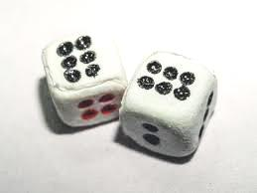


DISCRETE RANDOM VARIABLES
X(1) = 12
X(2) = 7
A discrete random variable is some variable, the numerical value of which will have exactly one value, which depends on random or otherwise unpredictable factors.
Distribution law for the values of a six-sided dice:
Distribution Law of a discrete random variable - Information describing the possible values for a variable and their corresponding probability

Slide 9

EXPECTATION VALUES
and variance
Expectation value of a discrete random variable - the sum of the products of all possible values and their corresponding probabilities.
=
The expectation value of a six-sided dice:
Variance – The average of the squared distances from the mean:
Mean Squared Error of a random variable – The interval in which it is more likely for the random variable to select its value from. It is calculated using the following equation:

